Slide 1
Emotion recognition through speech
Data Minions
Jaswanth Reddy Narala – 16355312
Sai Kishore Reddy Regatte - 16370947
Susmitha Edara -
Pranathi Gogada - 16369822

Slide 2
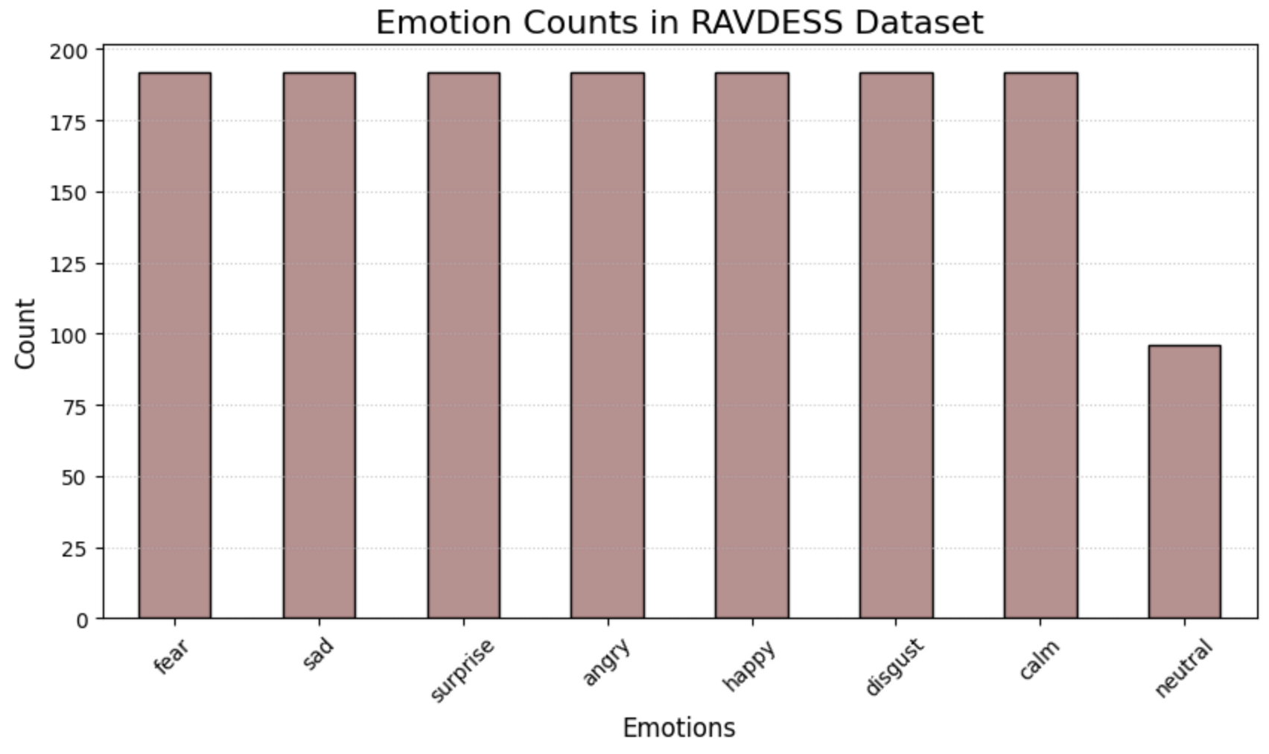
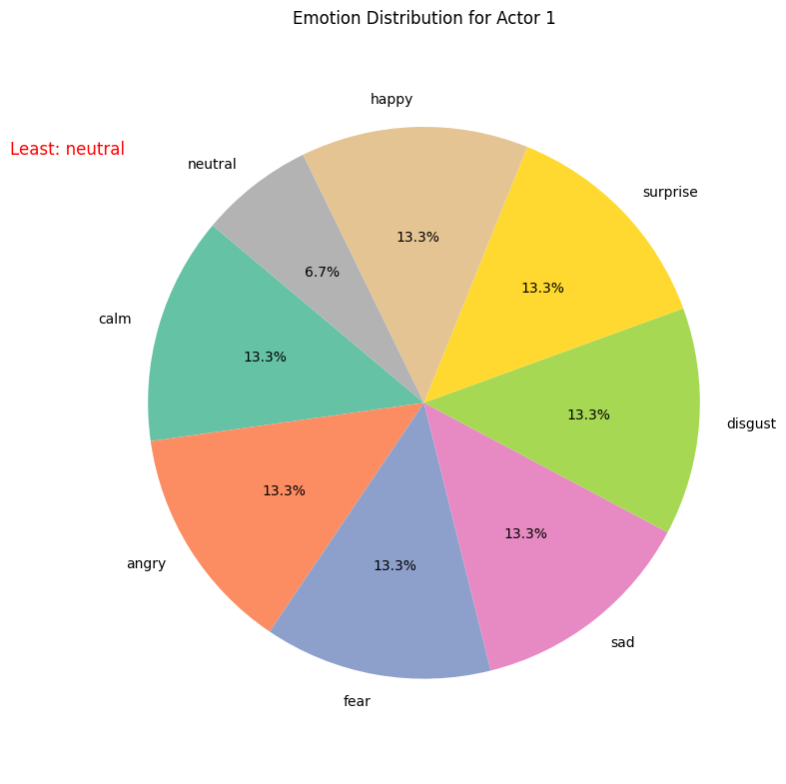
Exploratory Data Analysis
Bar graph represents number of audio files for each emotions
Pie chart shows emotions for Actor 1

Slide 3
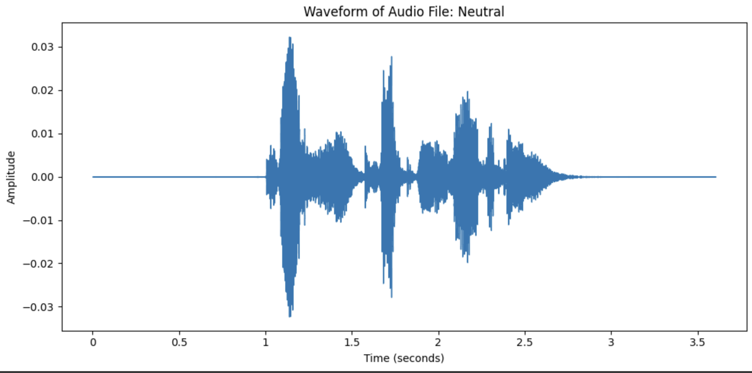
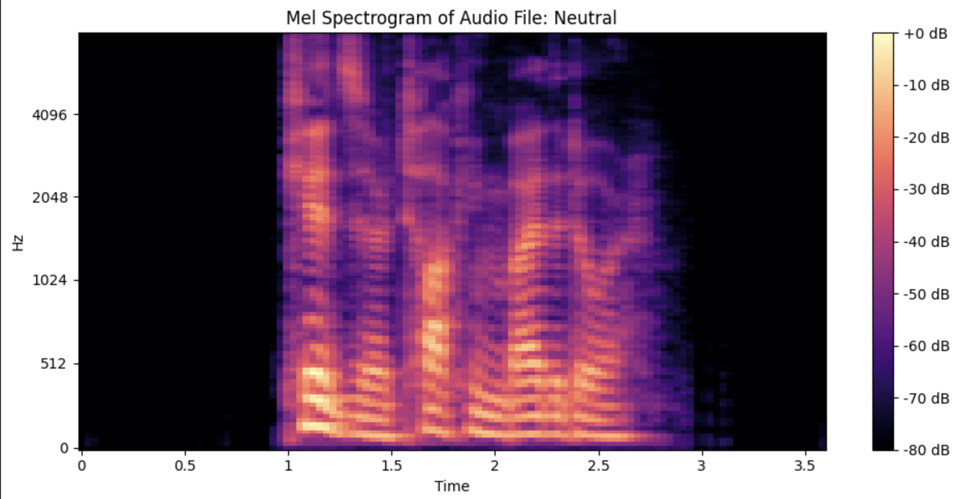
This image is a waveform representation of an audio signal labeled "Neutral.”
This image represents a spectrogram of an audio file labeled "Neutral."

Slide 4
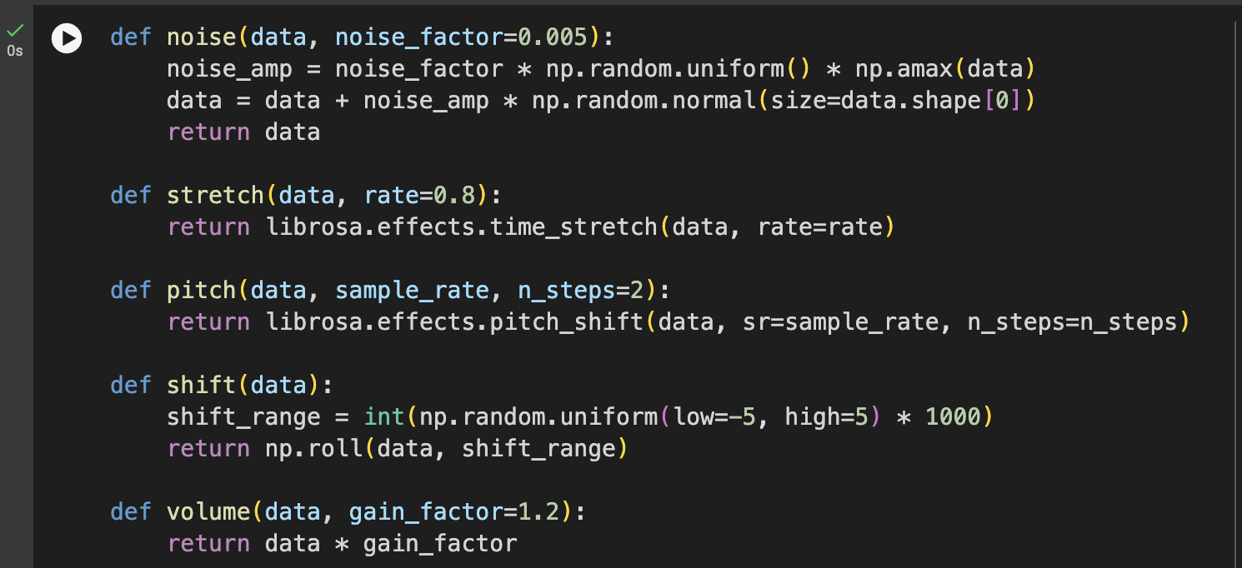
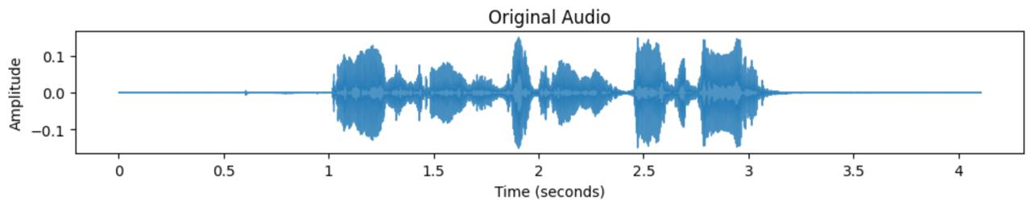
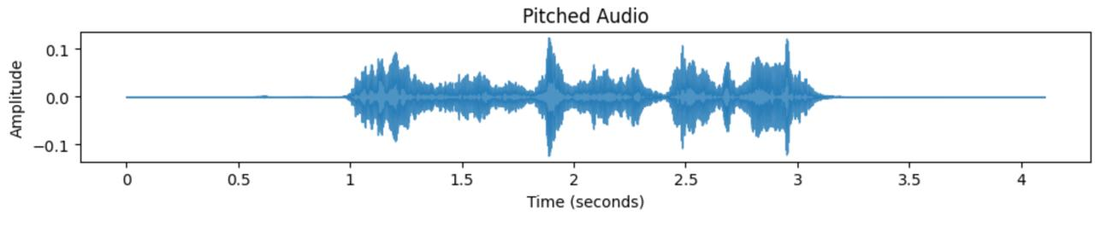

Data Augmentation

Slide 5
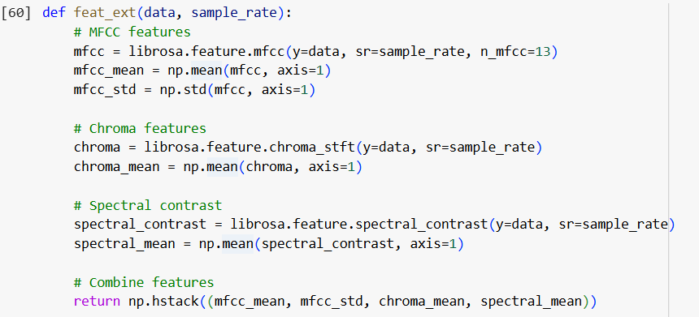
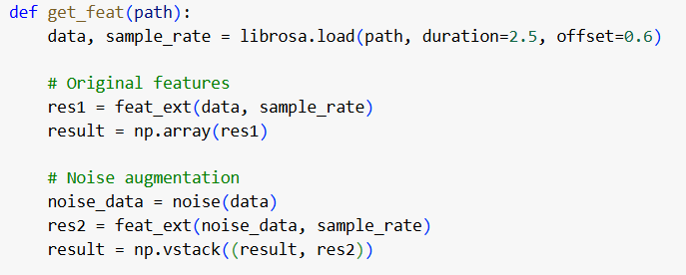
Feature Extraction
MFCC, chroma, spectral contrast features are extracted from audio signals with emotion labels and saved in emotion.csv file.

Slide 6
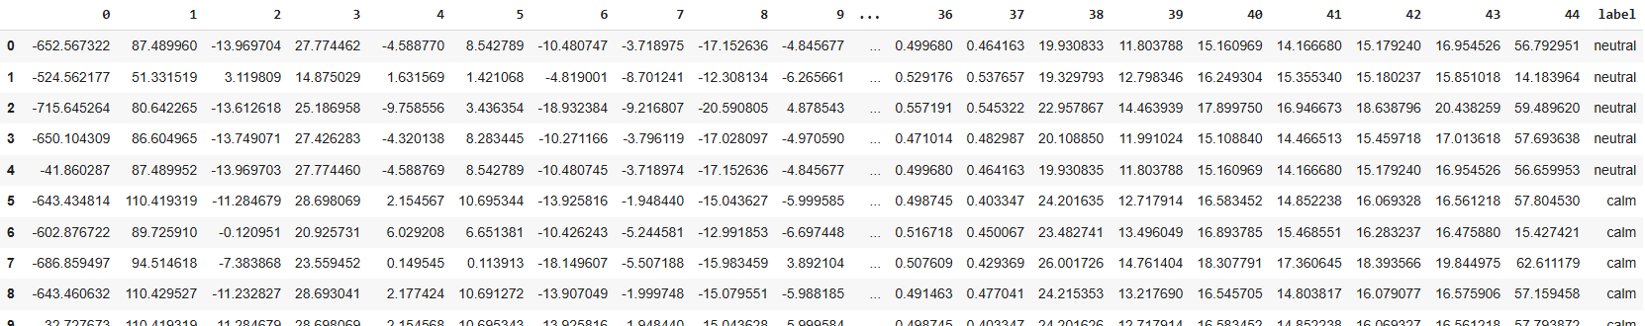

Slide 7
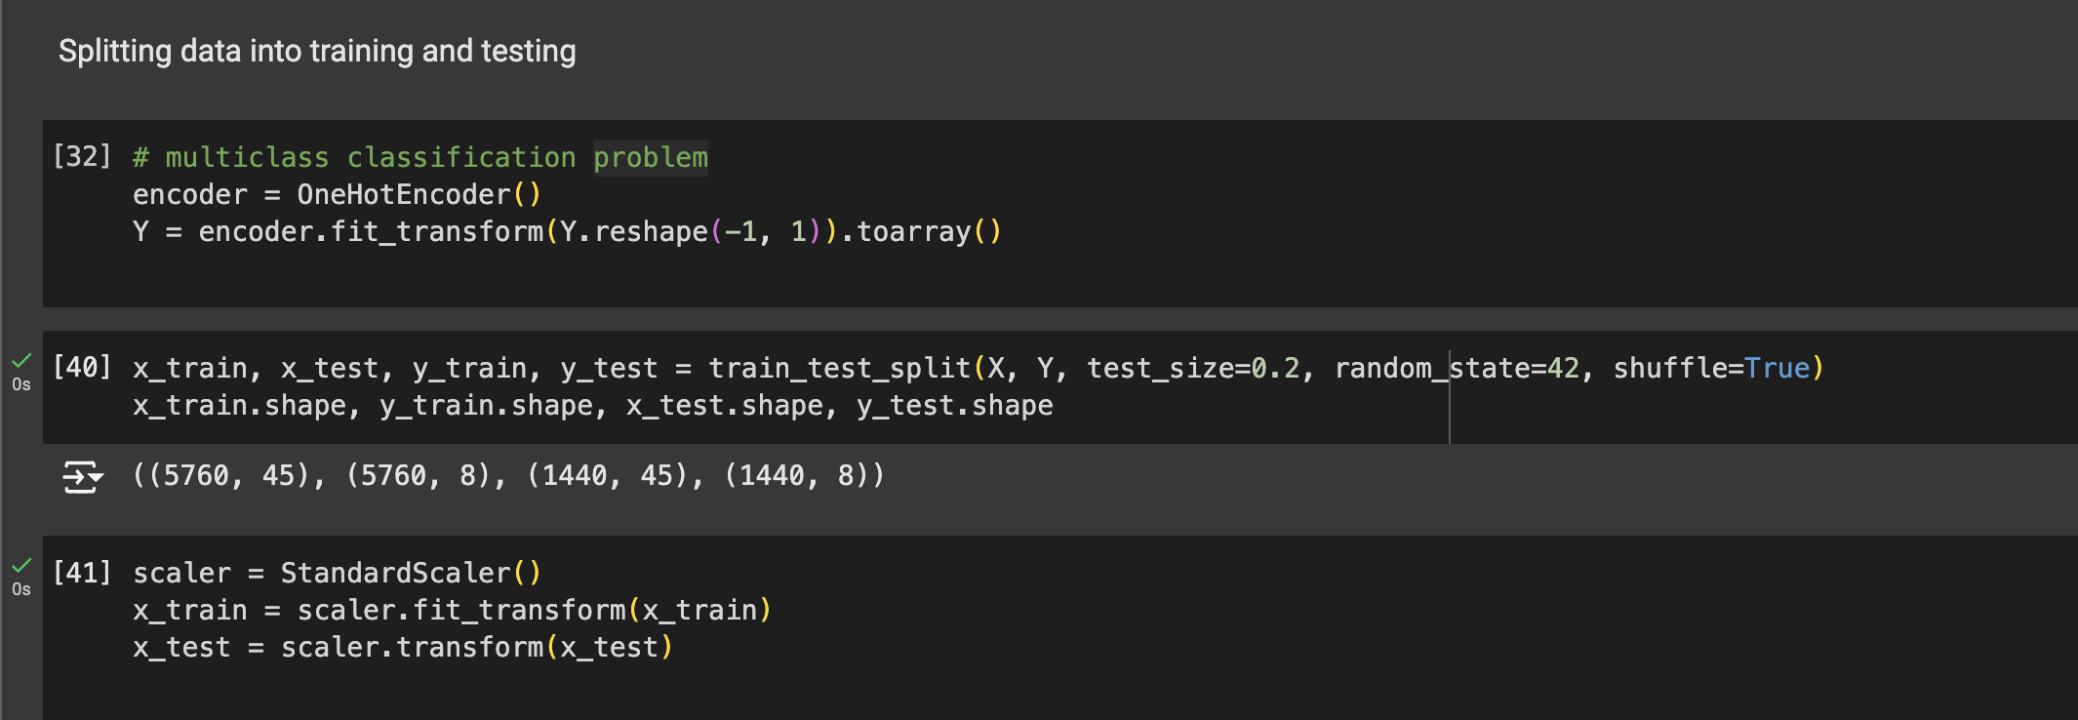
Data Preprocessing
This code performs data preprocessing, divides the dataset into training and testing subsets, and normalizes the features, ensuring they are ready for training a machine learning model for multiclass classification.

Slide 8
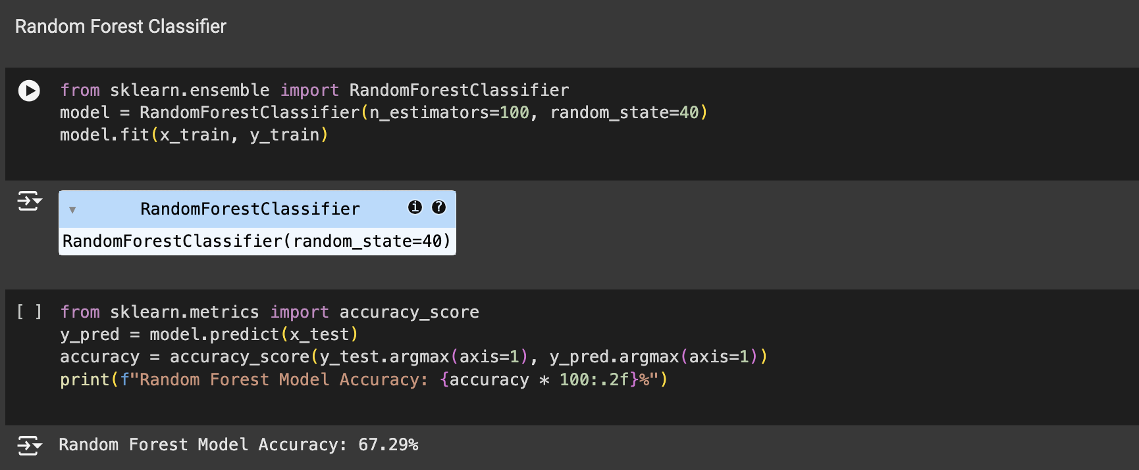
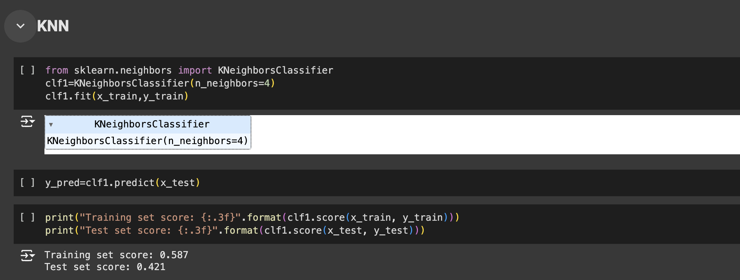
Deploying ML Models
→Random Forest Classifier → KNN

Slide 9
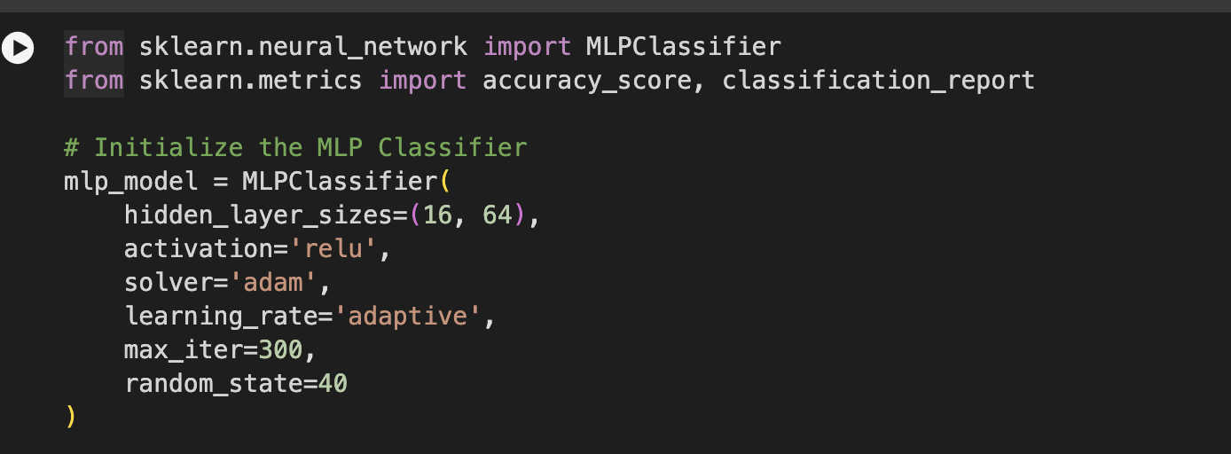
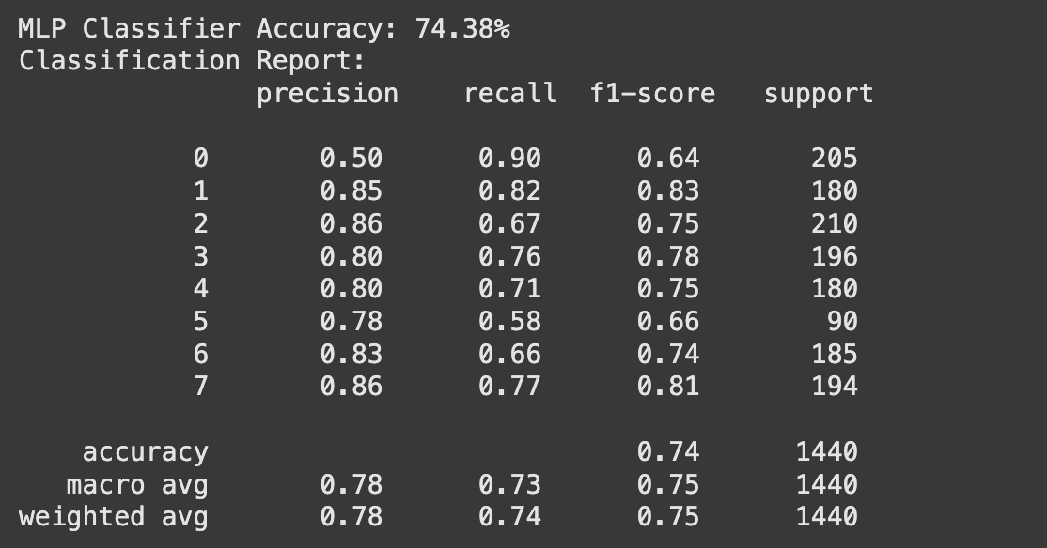
MLP

Slide 10
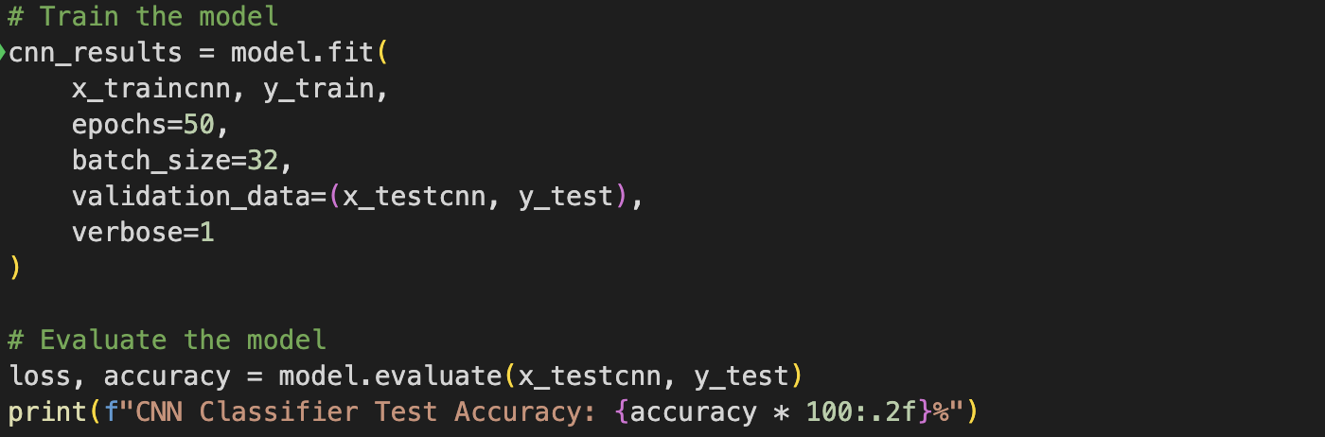
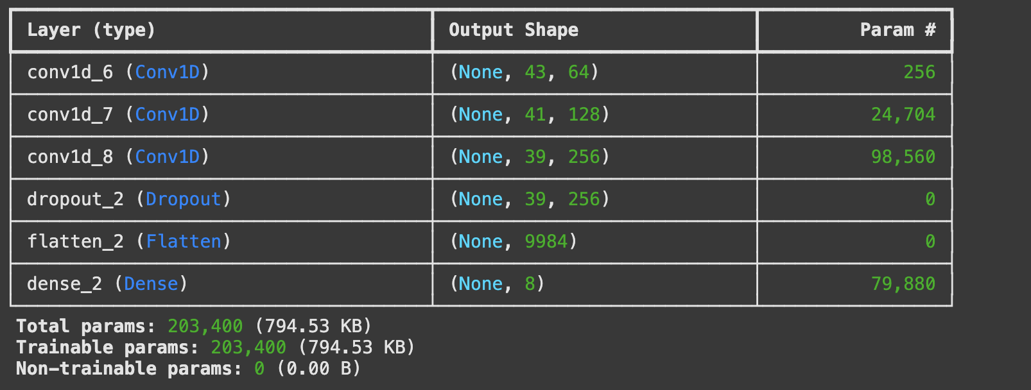
CNN
Convolutional Neural Network (CNN) architecture with several convolutional and pooling layers, followed by fully connected dense layers, designed for classifying sequential data.

Slide 11
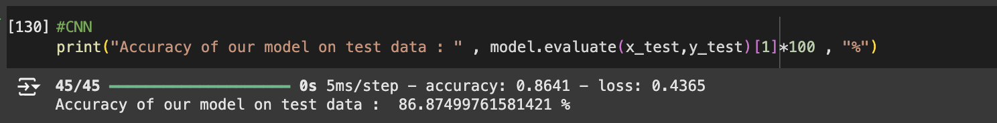
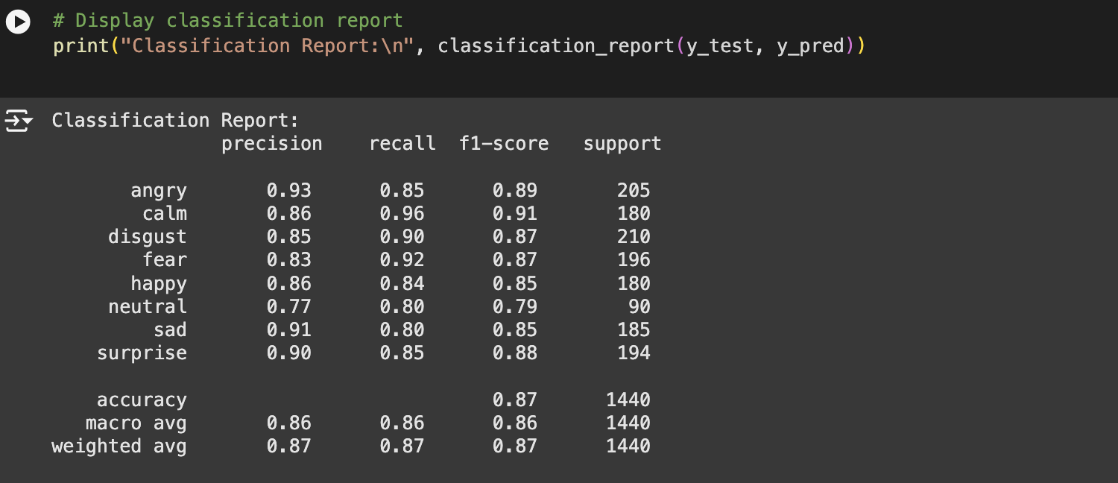
The CNN-based model achieved an accuracy of approximately 86.87% on the test data.

Slide 12
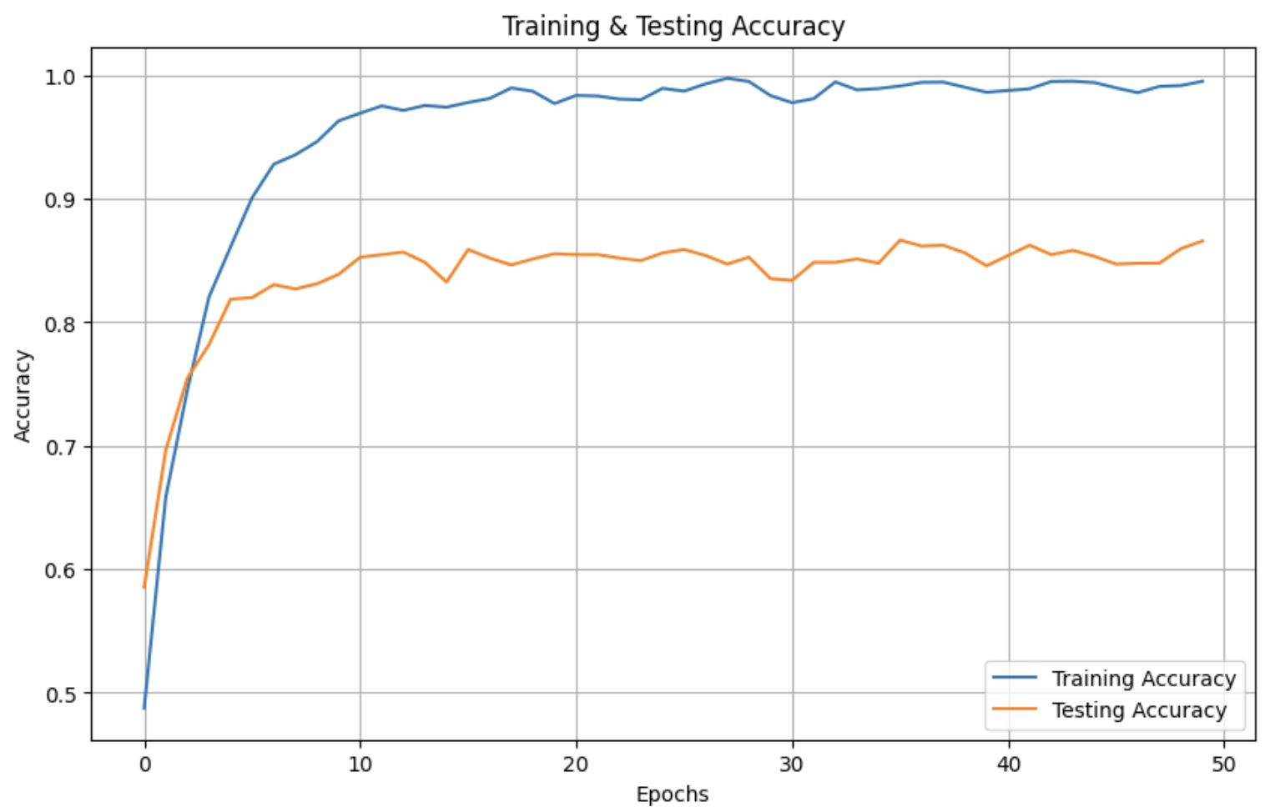
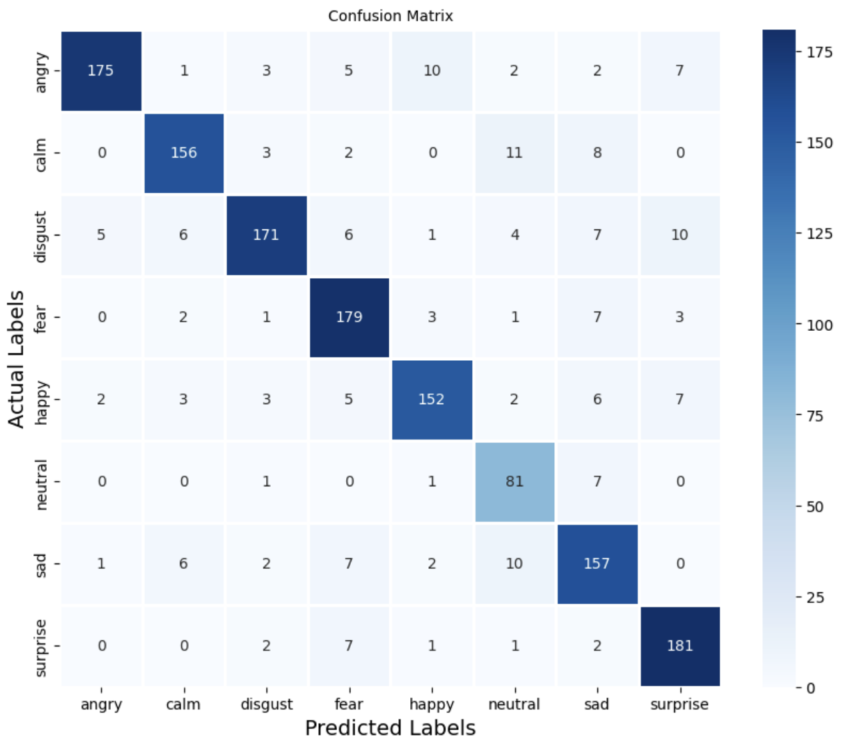
The CNN model achieved the highest accuracy of 86.70% on the test data, demonstrating its superiority over Random Forest, KNN and MLP models, attributed to its ability to automatically extract features from spatial data.

Slide 13
Thank you

